Slide 1
Lecture 4:
1.3. Theory: Determinants of the Rate of Growth
Brad DeLong
Department of Economics and Blum Center, U.C. Berkeley; WCEG; and NBER
last revised: 2020-02-04
Original course by Melissa Dell (Harvard Econ 1342), revised by Brad DeLong, research assistance by Anish Biligiri
<https://github.com/braddelong/public-files/blob/master/econ-135-lecture-4.pptx>

Slide 2
Lecture 4: Ideas Growth
Last of our three lectures on economic theory
Slides: <https://github.com/braddelong/public-files/blob/master/econ-135-lecture-4.pptx>
Read After: J. Bradford DeLong: Lecture Notes: Determinants of Progress <https://nbviewer.jupyter.org/github/braddelong/long-form-drafts/blob/master/solow-model-6-innovation.ipynb>
Files: datahub: <http://datahub.berkeley.edu/user-redirect/interact?account=braddelong&repo=long-form-drafts&branch=master&path=solow-model-6-innovation.ipynb>
Assignment: Malthusian economies paper <https://bcourses.berkeley.edu/courses/1487685/assignments/8065917>

Slide 3
MOAR References
Michael Kremer (1993): Population Growth and Technological Change: One Million B.C. to 1990 <https://delong.typepad.com/files/kremer-million.pdf>...
Charles I. Jones and Peter J. Klenow: Beyond GDP? Welfare across Countries and Time <https://web.stanford.edu/~chadj/JonesKlenowAER2016.pdf>...
Chang-Tai Hsieh, Erik Hurst, Charles I. Jones, & Peter J. Klenow: The Allocation of Talent & U.S. Economic Growth <https://web.stanford.edu/~chadj/HHJK.pdf>...
C.I. Jones: The Facts of Economic Growth <https://web.stanford.edu/~chadj/facts.pdf>...
Philippe Aghion, Benjamin F. Jones, & Charles I. Jones: Artificial Intelligence & Economic Growth <https://web.stanford.edu/~chadj/AJJ-AIandGrowth.pdf>...
Charles I. Jones: Paul Romer: Ideas, Nonrivalry, & Endogenous Growth <https://web.stanford.edu/~chadj/RomerNobel.pdf>...
Richard R. Nelson & Howard Pack: The Asian Miracle & Modern Growth Theory <http://citeseerx.ist.psu.edu/viewdoc/download?doi=10.1.1.977.8217&rep=rep1&type=pdf>...
Charles I. Jones & Paul M. Romer: The New Kaldor Facts: Ideas, Institutions, Population, & Human Capital <https://web.stanford.edu/~chadj/JonesRomer2010.pdf>...

Slide 4

Long-Run Patterns: Global h, g, & n

Slide 5

Long-Run Patterns: “Western” h, g & n
Where does the “ρ” come from?
“Ghost acreage”—conquest and resource utilization (sugar islands, timberlands, cottonlands, etc.)
Cultural expansion—Australia, Canada, New Zealand, & U.S.; Spain & Italy & Scandinavia; plus Japan, Korea, Taiwan, Hong Kong, & Singapore

Slide 6


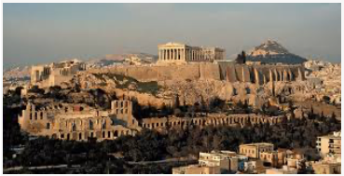
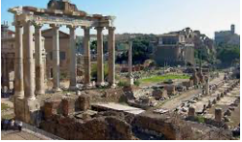
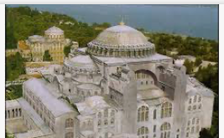
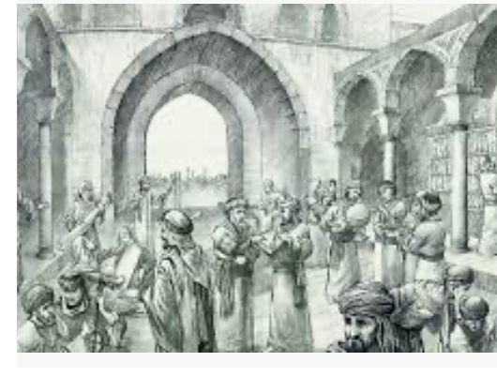


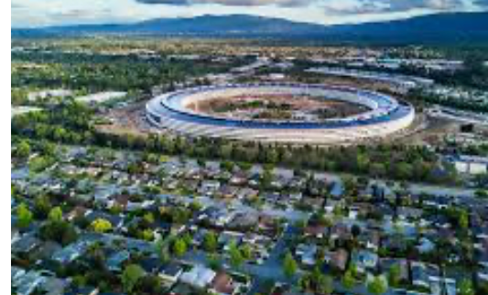
“West”?

Slide 7

Non-Rivalry
One person's work in adding to H can rapidly benefit all—if it is allowed to spread:
Attempts to keep it from spreading—to limit knowledge's distribution by somehow charging those using it a price—must violate the optimality condition that the costs imposed on people for making use of commodities reflect and match the burden that their withdrawal of the commodities from the common stock imposes on the rest of the community
Friedrich Engels (1843): Outlines of a Critique of Political Economy <https://www.marxists.org/archive/marx/works/1844/df-jahrbucher/outlines.htm>:
“According to the economists, the production costs of a commodity consist of three elements: the rent for the piece of land required to produce the raw material; the capital with its profit, and the wages for the labour required for production and manufacture.... [Since] capital is “stored-up labour”... two sides–the natural, objective side, land; and the human, subjective side, labour, which includes capital and, besides capital, a third factor which the economist does not think about–I mean the mental element of invention, of thought, alongside the physical element of sheer labour.
“What has the economist to do with inventiveness? Have not all inventions fallen into his lap without any effort on his part? Has one of them cost him anything? Why then should he bother about them in the calculation of production costs? Land, capital and labour are for him the conditions of wealth, and he requires nothing else. Science is no concern of his. What does it matter to him that he has received its gifts through Berthollet, Davy, Liebig, Watt, Cartwright, etc.–gifts which have benefited him and his production immeasurably?…"

Slide 8
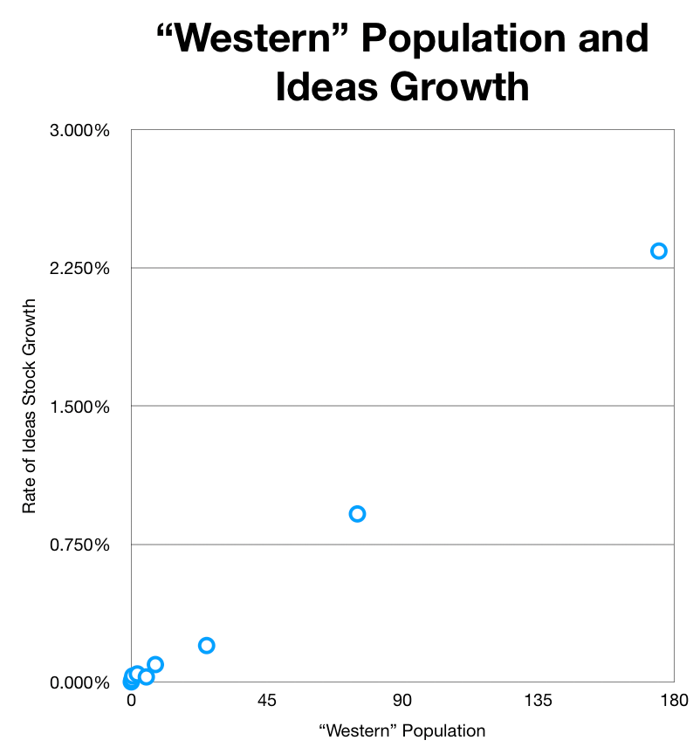
“Western” h & Population
Michael Kremer (1993): Population Growth & Technological Change: One Million B.C. to 1990:
<https://delong.typepad.com/files/kremer-million.pdf>
Two heads are better than one
Invention is proportional to the human population
Or to the human population in effective intellectual contact—the “West”
Or to the leading-edge population of the “West”
Or to the “West’s” STEM workforce
Cf.: Jared Diamond: Guns, Germs, and Steel <https://delong.typepad.com/files/diamond.pdf>
A race—between “the West”, “Greater China”, South Asia, the Middle East, Sub-Saharan Africa, Pre-Latin America, Australasia, Polynesia, Tasmania, Flinders Island?

Slide 9
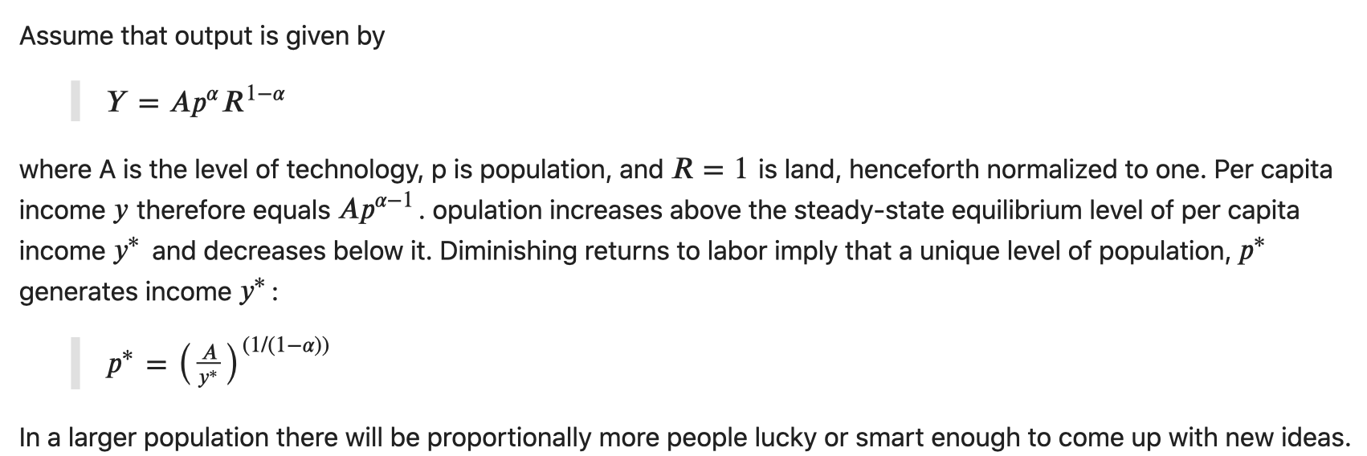
Implications of THABtO
Michael Kremer (1993): Population Growth & Technological Change: One Million B.C. to 1990:
We expect to see superexponential growth:

Slide 10
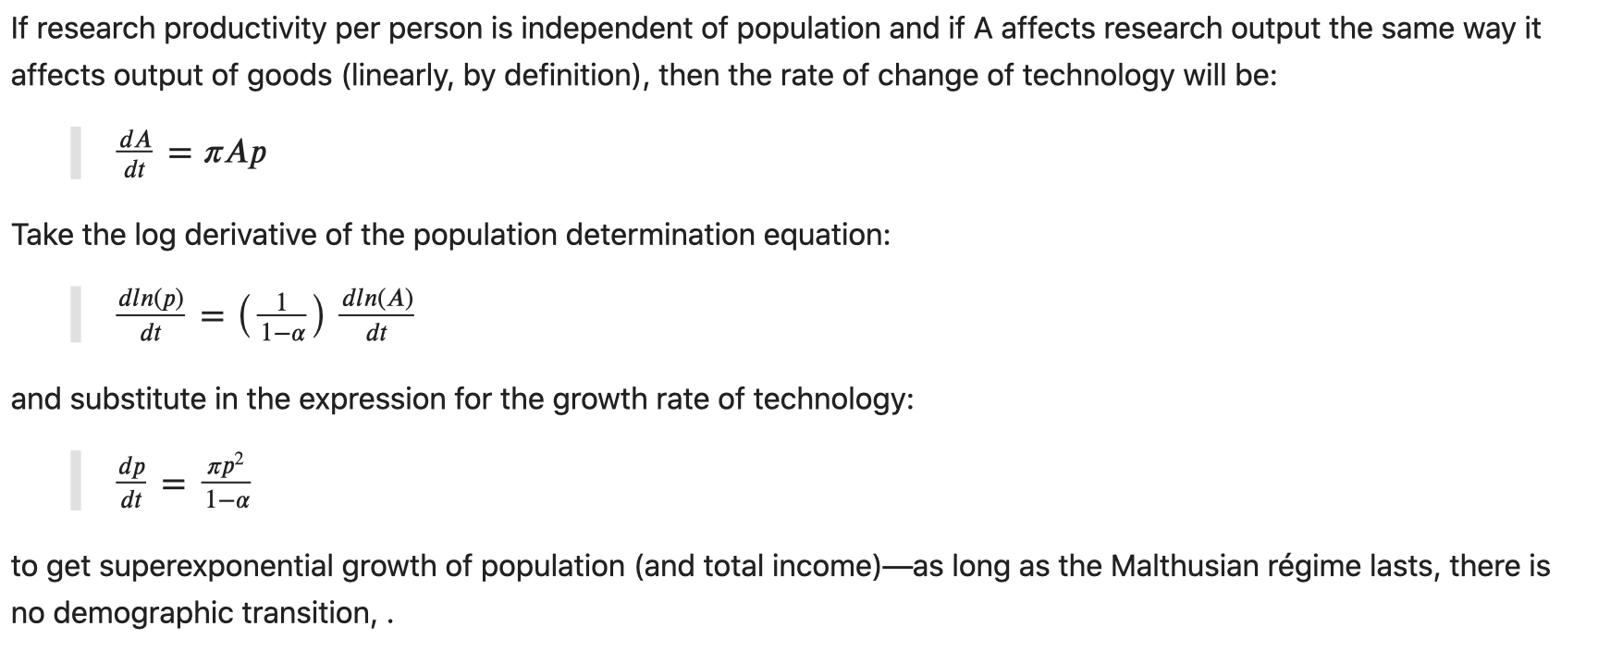
Implications of THABtO II
After the demographic transition (if one occurs), things will be different…

Slide 11
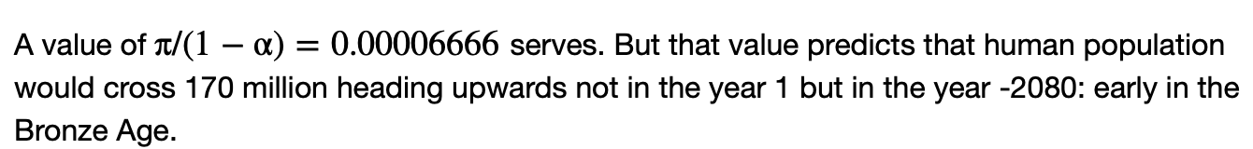
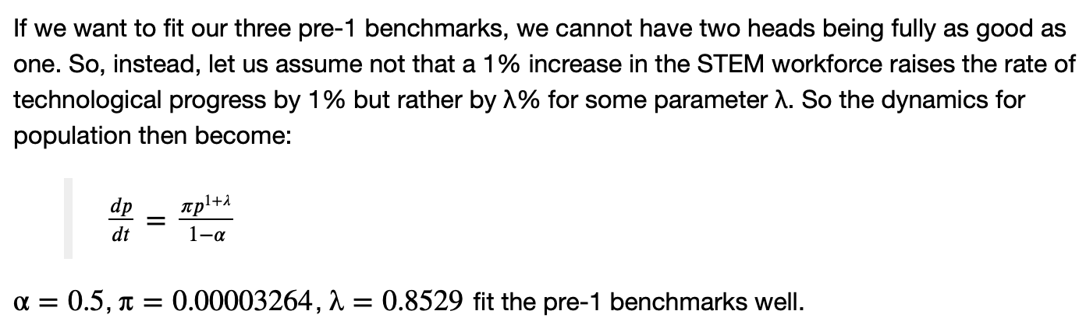
Computational Experiment
# fitting the Kremer model to historical population
There were 2.5 million people 10,000 years ago, at the invention of agriculture. There were 15 million people 5,000 years ago, at the invention of writing
datahub: <http://datahub.berkeley.edu/user-redirect/interact?account=braddelong&repo=long-form-drafts&branch=master&path=solow-model-6-innovation.ipynb>

Slide 12
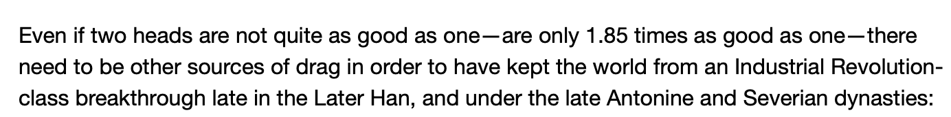
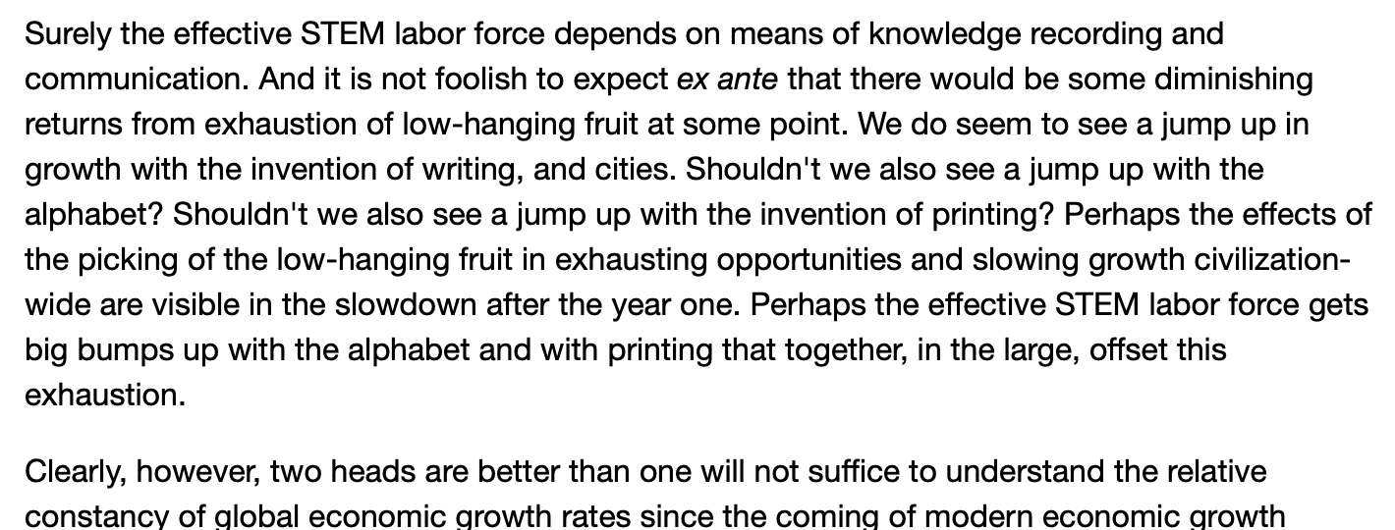
Computational Experiment II
# fitting the Kremer model to historical population
There were 2.5 million people 10,000 years ago, at the invention of agriculture. There were 15 million people 5,000 years ago, at the invention of writing
datahub: <http://datahub.berkeley.edu/user-redirect/interact?account=braddelong&repo=long-form-drafts&branch=master&path=solow-model-6-innovation.ipynb>

Slide 13
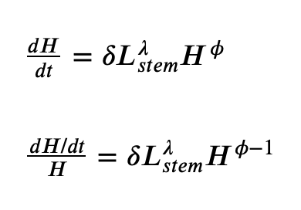
Looking for Constant h…
Charles I. Jones (1995): R&D-Based Models of Economic Growth:
<https://delong.typepad.com/files/jones-r--d.pdf>
“The prediction of permanent scale effects on growth from the R&D equation means that the models of Romer/Grossman-Helpman/Aghion-Howitt and others are all easily rejected.... However, the R&D-based models [remain] intuitively very appealing.... [Is there] a way to maintain the basic structure of these models while eliminating the prediction of [permanent] scale effects [on the rate of growth?]…"
Can we preserve the insights that ideas are non-rival and that technology is the ballgame and still understand why growth did not accelerate faster and bring us an Industrial Revolution early in the first millennium, and, in fact, has not further accelerated since the late 1800s? Chad Jones’s answer is: “Yes!”
Crowding of researchers, and
Picking of low-hanging technological fruit

Slide 14
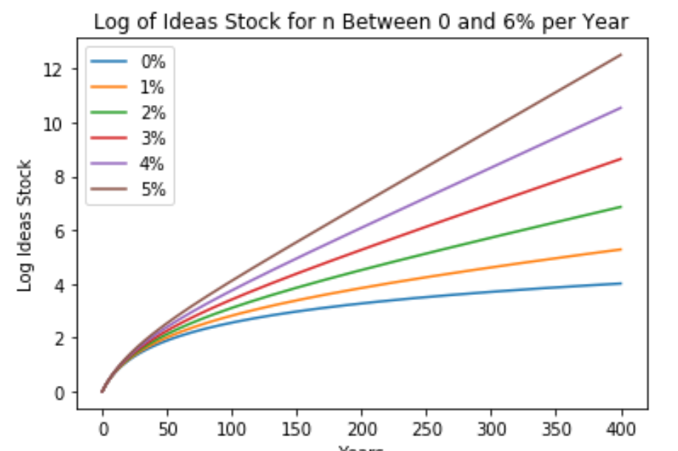
More Computational Experiments
Set the initial ideas stock H0 and the initial STEM labor force L0 at 1:
Set the R&D researcher crowding parameter 𝜆=0.5
For striking results, set the low-hanging-fruit parameter 𝜙=0.1
The rate of growth n of the STEM labor force varies from 0 to 6% per year

Slide 15
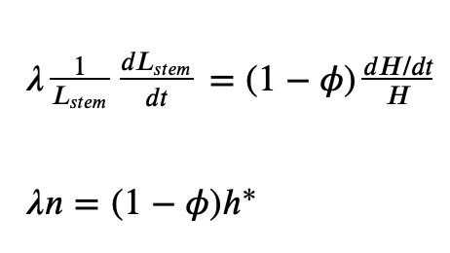
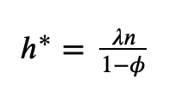
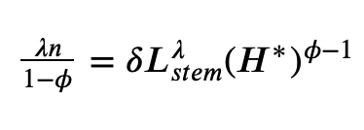
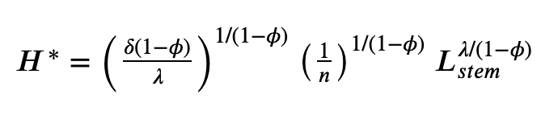
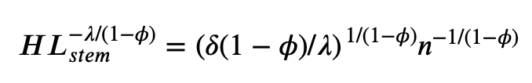
Understanding the Jones Model
Indeed: a steady-state in h:
For that convergence to a constant growth rate to happen, in the long run the increase in the effective STEM labor force 𝐿^{𝜆}𝑆𝑇𝐸𝑀 has to be exactly offset by diminishing returns to innovative effort 𝛿𝐻^{𝜙−1}
There will be a level of ideas H* at which that growth rate h* would be attained
The bigger is φ—the more low-hanging fruit is picked—the lower will be H* and the higher will be h*

Slide 16
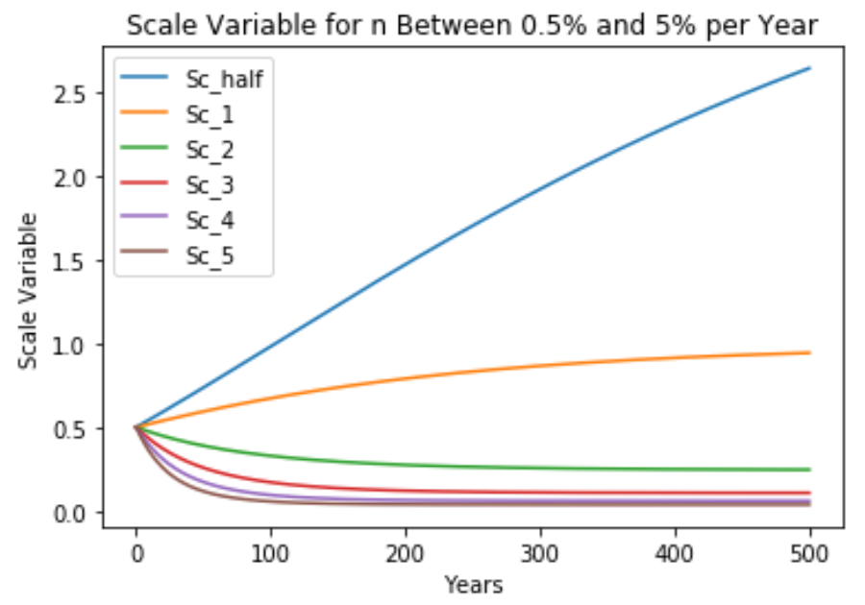
Superexponential Convergence
But over a long time span—not generations, longer:
𝐻 grows more rapidly than ℎ∗ until it closes in on 𝐻∗ on the steady-state balanced-growth path
First, initial superexponential growth; that growth rate then declines until the growth rate asymptotes to merely exponential growth at the rate ℎ∗ =𝜆𝑛/(1−𝜙)
We have an h* of 2%/year
We seem to have had an nstem of 6%/year
Looks like: 𝜆/(1−𝜙) = 1/3
𝜙 = 0.5 ⇒ 𝜆 = 0.17
𝜙 = 0.1 ⇒ 𝜆 = 0.3

Slide 17
Review: Solow-Malthus Model Basics
How do we make sense of the fact that people were ingenious and inventive back before 1500, and yet standards of living did not increase?
Although population did increase—slowly
Other parts of the model
Balanced-growth equilibrium
Convergence to equilibrium
Lecture notes: <https://nbviewer.jupyter.org/github/braddelong/long-form-drafts/blob/master/solow-model-5-pre-industrial.ipynb>
datahub: <http://datahub.berkeley.edu/user-redirect/interact?account=braddelong&repo=long-form-drafts&branch=master&path=solow-model-5-pre-industrial.ipynb>

Slide 18
Solow-Malthus Model Basics: Efficiency of Labor
How do we make sense of the fact that people were ingenious and inventive back before 1500, and yet standards of living did not increase?
We make efficiency of labor a function of available natural resources per worker. by setting the rate of efficiency of labor growth g = h - n/γ
Thus g = 0 if and only if: n = n^{*mal} = hγ.
Back before 1500—and even later—people are anxious to have children:
1/Φ is the fraction of production devoted to necessities
y^{sub} is the “subsistence” standard of necessities consumption at which population growth averages zero:
Then, back before the demographic transition: n = β(y/(Φy^{sub}) - 1)

Slide 19

Understanding the Solow-Malthus Equilibrium: Population and Labor Force
Notes:

Slide 20

Understanding the Solow-Mathus Equilibrium: Prosperity
Notes:

Slide 21

Steady-State and Along the Transition Path
The fall of an empire:
<https://nbviewer.jupyter.org/github/braddelong/LS2019/blob/master/2019-10-14-Ancient_Economies.ipynb>
A decline in inequality, taste for luxuries, and taste for urban living: Δφ = -0.25
A decline in law-and-order that produces a sharp fall in the savings rate: Δs = -0.10

Slide 22






Review: Solow Model Basics
Lecture Notes: <https://www.bradford-delong.com/2020/01/lecture-notes-the-solow-growth-model-the-history-of-economic-growth-econ-135.html>

Slide 23

Solving the Model

Slide 24

Along the Balanced-Growth Path
Everything except κ—which is constant—grows at a constant proportional rate: either n, or g, or n+g;
Labor force L grows at n
Income per worker y and the efficiency of labor E grow at g
Total income Y and the capital stock K grow at n+g

Slide 25
Big Ideas: Lecture 4: Idea Stock Growth
Takeaways from this lecture:
People were ingenious and inventive back before 1500, yet standards of living did not increase
Populations, however, did: slowly
THEN WE GET AN EXPLOSION
Two heads are better than one at R&D. Does not quite work…
Explosion too soon…
Even with research stepping on its toes…
And writing, cities, printing, &c. should have boosted research…
Picking the low-hanging fruit?
Agrarian age: h* = 0.035%/year; nstem = 0.07%/year; 𝜆/(1−𝜙) = 1/2
MEG age: h* = 2%/year; nstem = 6%/year; 𝜆/(1−𝜙) = 1/3
What causes the increase in Lstem?
What institutions make it profitable for nstem to be higher?

Slide 26
Catch Our Breath…
Ask a couple of questions?
Make a couple of comments?
Any more readings to recommend?

Slide 27
Notes

